Slide 1
Introduction to Electronic Mail Security and Pretty
Good Privacy (PGP)
1

Slide 2
Contents
E-mail security requirements
Pretty Good Privacy (PGP)
PGP Operational Description
Digital Signature and Message Encryption
Quick Overview of PGP
Order of Operations in PGP
Summary of PGP
2

Slide 3
Electronic Mail Security
"PGP has become a de-facto standard around the world. It is generally believed by experts to be unbreakable in a useful time (at least hundreds of years). Only intended recipient can read the encrypted message. Not Organised Crime, not the NSA, not the FBI, NOBODY. ”
3

Slide 4
Email Security Objectives
Privacy/Encryption
Message integrity
Authentication
Non-repudiation
4

Slide 5
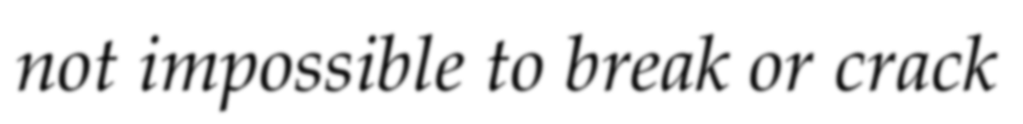

What is PGP?
PGP is a program to secure electronic mail to ensure Privacy and Authenticity
It has proven itself quite capable of resisting even the most sophisticated forms of analysis
PGP can be used to apply a digital signature and encrypt/decrypt a message
Written by Phil R Zimmermann
5

Slide 6

Demonstration
https://www.youtube.com/watch?v=Ro3MSBS9w-A

Slide 7
Reasons for PGP’s popularity?
PGP/OpenPGP is available free worldwide
OpenPGP is branch of PGP
"use no algorithm with licensing difficulties"
Available on a variety of platforms including DOS/Windows, Unix, Macintosh, and many more
PGP is based on algorithms that have survived extensive public review and are considered extremely secure
PGP has a wide range of applicability
PGP was not developed by, nor is it controlled by, any governmental or standards organisation

Slide 8
Features of PGP
Combination of algorithms in a set of utility software for:-
encryption of messages, digests, and keys
message digest used for digital signature
key generation for private session key
key generation for users' public/private key pairs
key management and certification cyclic redundancy check (CRC)

Slide 9

Public Keys
Each user has a private key as well as a copy of the public key of each potential correspondent
PGP maintains a list of public keys that the user has obtained by one means or another. i.e thru email
Each item on public key ring includes several parts, as listed below:
The public key itself
The User ID of the owner of this public key
A key ID; an unique identifier for this key
Other information related to the trustworthiness of the key and its owner

Slide 10
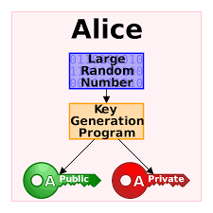
Private Keys
Each PGP must have a private key
The private key, must be handled with more care.
It is stored on the user’s private key ring
Recommended to store this private key ring on a secure USB disk for security reason
To access the key, “passphrase” is required
It can accept a phrase or a sentence, not necessary to be a single word

Slide 11
Private Keys (cont’d)
PGP then uses that passphrase to generate a symmetric Key (e.g. 128-bit IDEA [International Data Encryption Algorithm] key ) and encrypts the private key using the chosen algorithm and the passphrase-based key.
For each private key, it includes the following information:
The private key, encrypted using the passphrase- based key
The owner’s Used ID
A copy of the matching public key

Slide 12
Operational Description
The actual operation of PGP for sending and receiving messages, consists of the following FIVE services:-
Digital Signature
Message Encryption
Compression
E-mail Compatibility
Segmentation and Reassembly

Slide 13
Operational Description (cont’d)
Function | Algorithms | Description
Digital | DSS/SHA-1 | A hash code of a message is
Signature | or | created using SHA-1. This
 | RSA/SHA | message digest is encrypted using
 |  | DSS or RSA with the sender’s
 |  | private key, and included with the
 |  | message.
Message | CAST or IDEA or | A message is encrypted using
Encryption | Three-Key Triple DES | CAST-128 or IDEA or 3DES with
 | with Diffie-Hellman | one-time session key generated by
 | or RSA | the sender. The session key is encrypted using Diffie-Hellman or
 |  | RSA with the recipient’s public
 |  | key, and included with the
 |  | message.
RAS

Slide 14
Operational Description (cont’d)
Function | Algorithms | Description (continue)
Compression | ZIP | A message may be compressed, for storage or transmission, using ZIP.
Email Compatibility | Radix 64-conversion | To provide transparency for e- mail applications, an encrypted message may be converted to an ASCII string using radix-64 conversion.
Segmentation & Reassembly | Nil | To accommodate maximum message size limitations, PGP performs segmentation and reassembly.

Slide 15
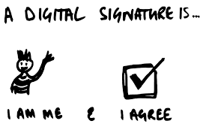
Digital Signature
The first step in the generation of a PGP message is the digital signature process. The sequence is as follows:
The sender creates a message
PGP uses SHA-1 to generate a 160-bit hash code of the message
The sender specifies the private key to be used (digital signature) for this operation and provides a passphrase, enabling PGP to decrypt the sender’s private key
PGP encrypts the hash code with RSA using sender’s private key and the result is prepended to the message
Notes:
Pay Special Attention

Slide 16

Digital Signature (cont’d)
The receiver uses RSA with the sender’s public key to decrypt and recover the hash code
The receiver generates new hash code. If the two match, the message is accepted as authentic
The combination of SHA-1 and RSA provides an effective scheme
The strength of RSA ensures that only the possessor of the matching private key can generate the signature
Notes:
Pay Special Attention

Slide 17
Digital Signature (cont’d)
A sample of Digital Signature generated using PGP software is shown below
-----BEGIN PGP SIGNED MESSAGE-----
Hash: SHA1
This is a test by PGP
-----BEGIN PGP SIGNATURE-----
Version: PGPfreeware 6.0.2i
iQA/AwUBNx/iiIIwA9hdbcRNEQIlqwCeJqlpYOBAe73ym1JT/KKLU9eQBVcAn1ce xWJ/04Izku0uQB6QlibpOMDM
=OSfJ
-----END PGP SIGNATURE-----

Slide 18
Message Encryption
In PGP, confidentiality is achieved by encrypting messages to be transmitted or stored locally as files
In both cases, the conventional encryption algorithm CAST-128 (symmetric algorithm) may be used
Other algorithms such as IDEA or 3DES may be used. The 64-bit cipher feedback (CFB) mode is used
As always, one must address the problem of key distribution
In PGP, each conventional key is used only once

Slide 19
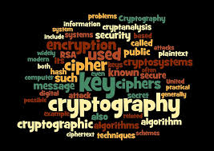
Message Encryption (cont’d)
That is, a new key is generated as a random 128-bit number for each message
Although this key is referred to in the documentation as a session key, it is in reality a one-time key
Because it is to be used only once, the session key is bound to the message and transmitted with it
To protect the key, it is encrypted with the receiver’s public key

Slide 20
Message Encryption (cont’d)
PGP - The steps in encrypting a message:
The sender generates a message and a random 128bit number to be used as a session key for this message only
The message is encrypted, using CAST-128 (or IDEA or 3DES) with the session key
The session key is encrypted with RSA, using the recipient’s public key, and is prepended to the message
The receiver uses RSA with its private key to decrypt and recover the session key
The session key is used to decrypt the message
Notes:
Pay Special Attention

Slide 21

Message Encryption (cont’d)
PGP Message Encryption Process
Receiver supplies passphrase
Sender’s Public Key Ring
receiver’s Public Key
Receiver’s Private Key Ring
Key ID attached to session key
Obtain private key
Encrypt session key using RSA
Boris Alice Samson
Internet
Boris
one-time session key
Generate one-time session key using random number generator
Decrypt one-time session key using RSA
This is a PGP message from Alice to Boris which is a plaintext
This is a PGP message from Alice to Boris which is a
plaintext
Encrypt using CAST-128 or
IDEA or 3DES
Decrypt using CAST-128 or
IDEA or 3DES
Encrypted copy of session key added (RSA) using receiver’s public key
Encrypted message received

Slide 22
Message Encryption (cont’d)
A sample of message encryption using PGP software is shown below
Plaintext text - “This is an encryption test on PGP” becomes the following text
-----BEGIN PGP MESSAGE-----
Version: PGPfreeware 6.0.2i
qANQR1DBwU4DQJqLyGZqVd0QCADh6RMrm+NnBECJxW3bnA3xQZVXbQ0EaRSXJ0r/
5Nsp8LW1R23l1cQ2BXcl/BJc+3fFMQ0VE1oMAVvtljVbFPDWyPqcmYNDSXa/6DCV
DqD+bZ6pd9zrj+HxoRYKOLC61PzX0Vl0uHVgbMHgyIDyWy5V9lEdBbcetXnYBbLc 76+/ii9DcpYU5UO/lax9IdRgRAyfJ5k17jyRsgJ8IJpSaIKJC51zguGUAB/GV3ra cfO/EK1jx6YFyUJN4X+SmpraQF8N4+j+fsm3zcQDaCaiN66W4hIBlmFMq3H1x0Af QsvP1IiZ2WIaeyEpUZapJV9S0j44olljweSxygSx+Ly9aD4RCADHuxm3ZbnT4OFA xDMw4VrLwQpzorY9ZIaeQKkYFdszF1mR72rXjML1WT6DS8nXrDxt15Rb4A1VzDMi G3dQgjIej9/CiqNzzyAT+CSmfCaIYm8eZRNs/coMHQM5XAydtte5ihR7KbcY14eD aY4w05zB2XM480eYyw3y3Lp49fcTj5Y6nTkdqFgMnVlZDbJno8i08rgpxM5Vpse8 DzGiL/vuh2E4zWy/TKveviJjrcDRGJVk7t3f+x9pHE5jusDNOWURucQ/Xlh5orY7 aP3VuK3io2t3i7a3unrpAJkv2eww01/FvNUtX5yUThgFsB41UhvBXoStQrb4tuMu L7kOnmMgyTUgr/dxYatzDPYB7j4cw7P67kF6j1b+/pik/dVhC6da3fQYQR64ppDe qpsAqVFLCO9RfXxAfg==
=3tyi
-----END PGP MESSAGE-----

Slide 23
Digital Signature and Message Encryption
Both digital signature and message encryption can be used together
This provides authenticity and confidentiality
The digital signature is first generated for the plaintext message and prepended to the message
Then the plaintext message plus signature is encrypted using CAST-128 (or IDEA or 3DES)
The session key is encrypted using RSA (or ElGamal)
Notes:
Pay Special Attention

Slide 24



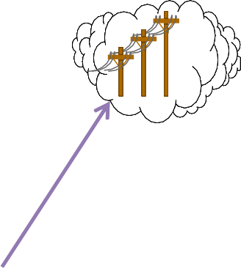

Message Encryption with Digital Signature (cont’d)
Message Encryption and Digital Signature Process
Sender’s Private Key Ring
Sender supplies passphrase
Sender’s
Public
Key Ring
receiver’s Public Key
Obtain Private Key
Alice
Encrypt session key using RSA
Boris
Alice
Samson
Sender’s Private Key
Genrate hash code using SHA-1
Generate signature using RSA
Generate one-time session key using random number generator
Signature
This is a PGP message from Alice to Boris which is a
plaintext
This is a PGP message from Alice to Boris which is a
plaintext
Encrypt using CAST-128 or
IDEA or
3DES
Digital Signature added (SHA-1/RSA) using sender’s
private key
Encrypted copy of session key added (RSA) using receiver’s public key
24

Slide 25




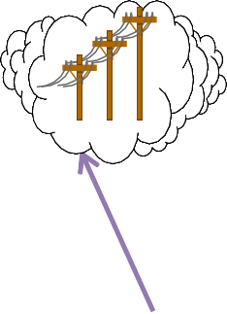

Message Decryption with Digital Signature (cont’d)
Message Verification and Decryption Process
Receiver
supplies passphrase
Receiver’s Private Key Ring
Receiver’s
Public Key Ring
Obtain private key
sender’s Public Key
Key ID
attached to session
key
Boris
Alice
Samson
Boris
Key ID attached to session key
one-time session key
Decrypt
signature using RSA
Decrypt one-time session key using RSA
Signature
This is a PGP message from Alice to Boris which is a plaintext
 |  | Generate hash code using SHA-1
Decrypt using CAST-128 or
IDEA or
3DES
Compare
Encrypted
message received
Signed Plain text
25

Slide 26
Compression
By default, PGP compresses the message after applying the signature but before encryption
Data compression saves transmission time and disk space
More importantly, it strengthens cryptographic security
Data compression reduces redundancy thereby enhancing resistance to cryptanalysis
It takes extra time to compress the plaintext, but from a security point of view it seems worth it

Slide 27
Compression (cont’d)
PGP uses a commonly used compression technique called ZIP, which is a freeware package
In essence, the operation of the ZIP algorithm is as follows:
It looks for repeating strings of characters in the input and replaces these with compact codes
The destination system performs the same function and replaces these codes with the original text
The more redundancy, the more effective the zip algorithm
Typical text files compress to about 50% of their original length.

Slide 28
Radix-64 Conversion
When PGP is used, at least part of the block to be transmitted is encrypted
Signature Services - the message digest is encrypted (with the sender’s private key)
Confidentiality - both the message and the signature (if present) are encrypted (with a one-
time symmetric key)
Thus, part of all of the resulting block consists of a stream of
24 Bits
R64
R64
R64
R64
arbitary eight-bit bytes
4 characters = 32 Bits

Slide 29
Radix-64 Conversion (cont’d)
Many electronic mail systems only allow messages made of ASCII text
8-bit raw binary data is not supported. i.e not readable
PGP supports ASCII radix-64 format for ciphertext messages
This special format represents binary data by using only printable ASCII characters
It is useful for transmitting encrypted data as normal E-mail text.

Slide 30
Radix-64 Conversion (cont’d)
This format acts as a form of transport armour, protecting it against corruption on Internet
PGP also appends a CRC (Cyclic Redundancy Check) to detect transmission errors
Radix-64 format converts the plaintext by expanding block of 24 bits into 4 printable ASCII characters (32 bits)
The file grows by about 33 percent, consider that the file probably was compressed more than that by PGP before it was encrypted.

Slide 31
Segmentation and Reassembly
Electronic mail facilities often are restricted to a maximum message length
Any message longer than the pre-specified size must be broken up into smaller segments, each of which is mailed separately
PGP automatically subdivides a message that is too large into segments that are small enough to send via e-mail
The segmentation is done after all of other processing, including radix-64 conversion

Slide 32
Segmentation and Reassembly (cont’d)
The session key component and signature component appear only once, at the beginning of the first segment
At the receiving end, PGP must strip off all e-mail header and reassemble the entire original block (i.e text)
This is before performing any appropriate steps to verify or decrypt any message

Slide 33
The Order of Operations in PGP
Brief description of the sequence of operations of PGP:
Create a private and public key pair
Exchange public keys with others
Validate your keys
Sign and encrypt your email and files
Decrypt and verify your email and files

Slide 34
PGP e-mail Summary
The de-facto standard for email encryption
Strong and sound underlying cryptography techniques being used
It is a freeware package and commercial version is also available
Cross-platform e-mail communications
PGP is packaged in a single application which performs encryption, decryption, signing, verification, and key management

Slide 35
Summary
Requirements of electronic mail security
Overview of Pretty Good Privacy (PGP)
Operations of PGP

